Slide 1

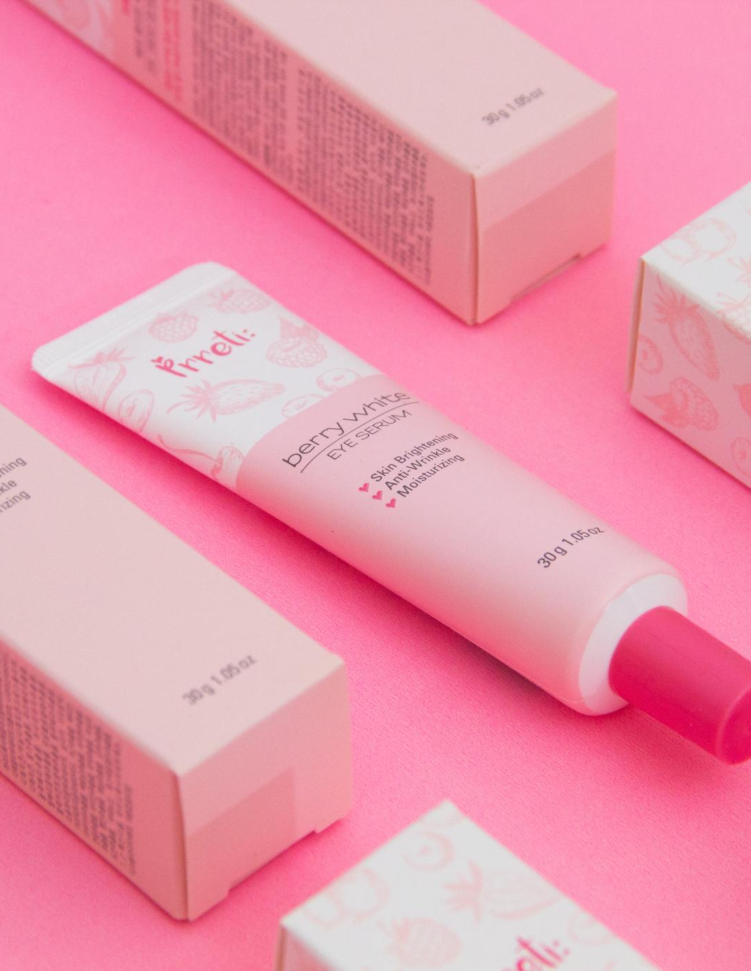
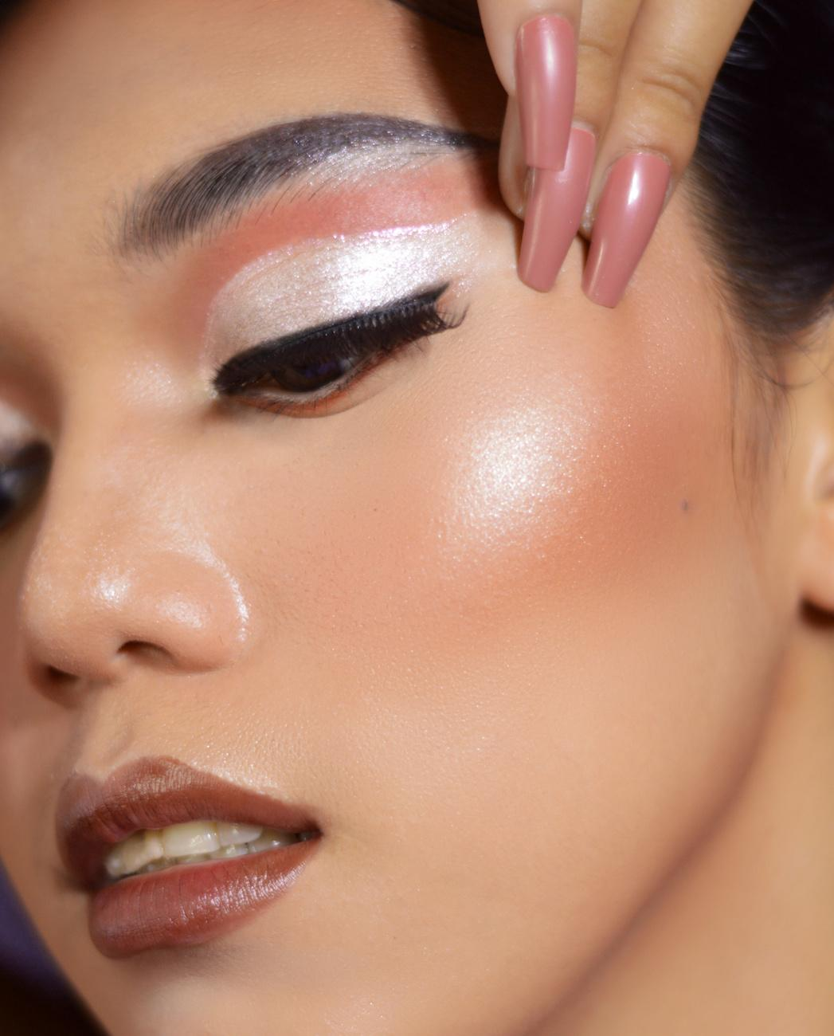

BeautyBot:
Product Ratings Prediction
by: Kasia J. Windett

Slide 2

Non-Technical Overview
Problem Statement
More times than often, brands in the beauty industry have a hard time predicting whether or not their consumers will like a product they’re selling. Brands, retailers, product development and marketing teams often have trouble with predicting product success and customer satisfaction, identifying optimal pricing and stock strategies, and understanding customer preferences.
Proposed Solution
A solution that is ideal for this type of problem is building a predictive model using data science. To be more specific, there will be multiple models built and developed to find the best one, such as linear regression. This ideal model will predict customer ratings, that way businesses can analyze their goals and customers more effectively.
Impact
This solution will add value to businesses by having product improvement, inventory optimization, higher customer loyalty, and reduced return rates. Beauty companies will gain insight from the predictive feedback to tailor their formulas, packaging, or marketing strategy. Beauty retailers, such as Sephora, can predict which products will be rated high to stock more inventory or reduce their overstock on low-demand products. Customers will have fewer returns to make because the products will meet their expectations, if not, surpass them.

Slide 3
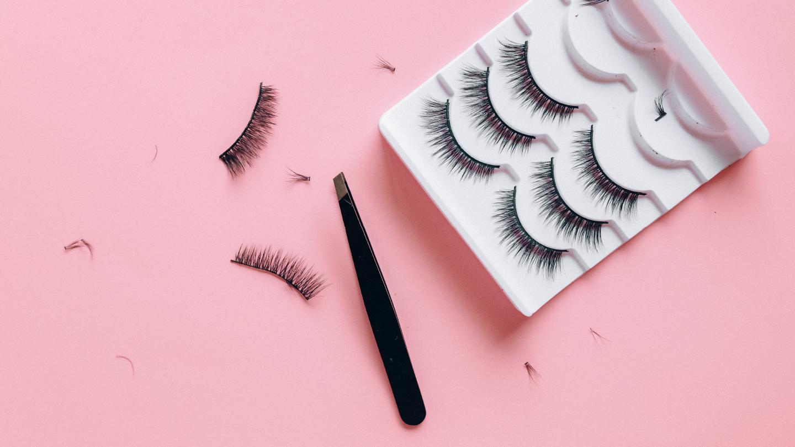
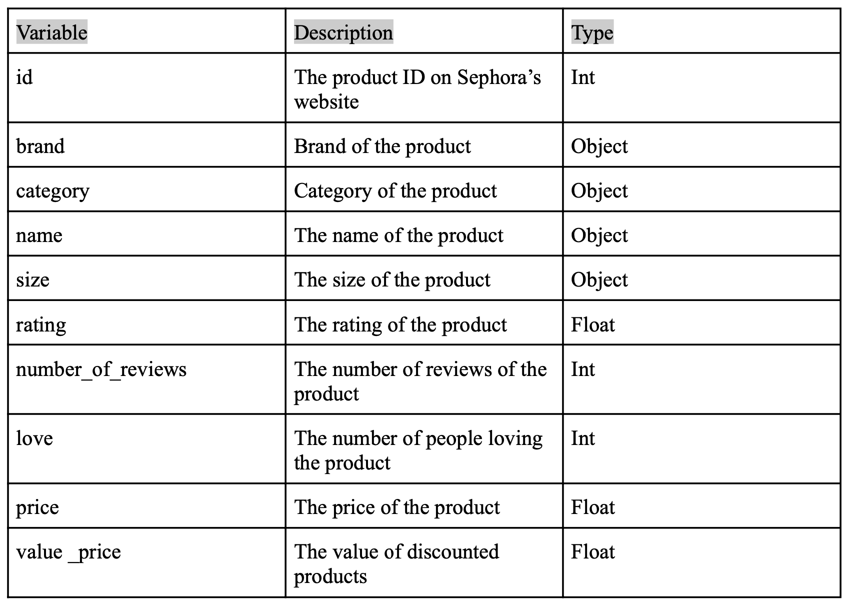
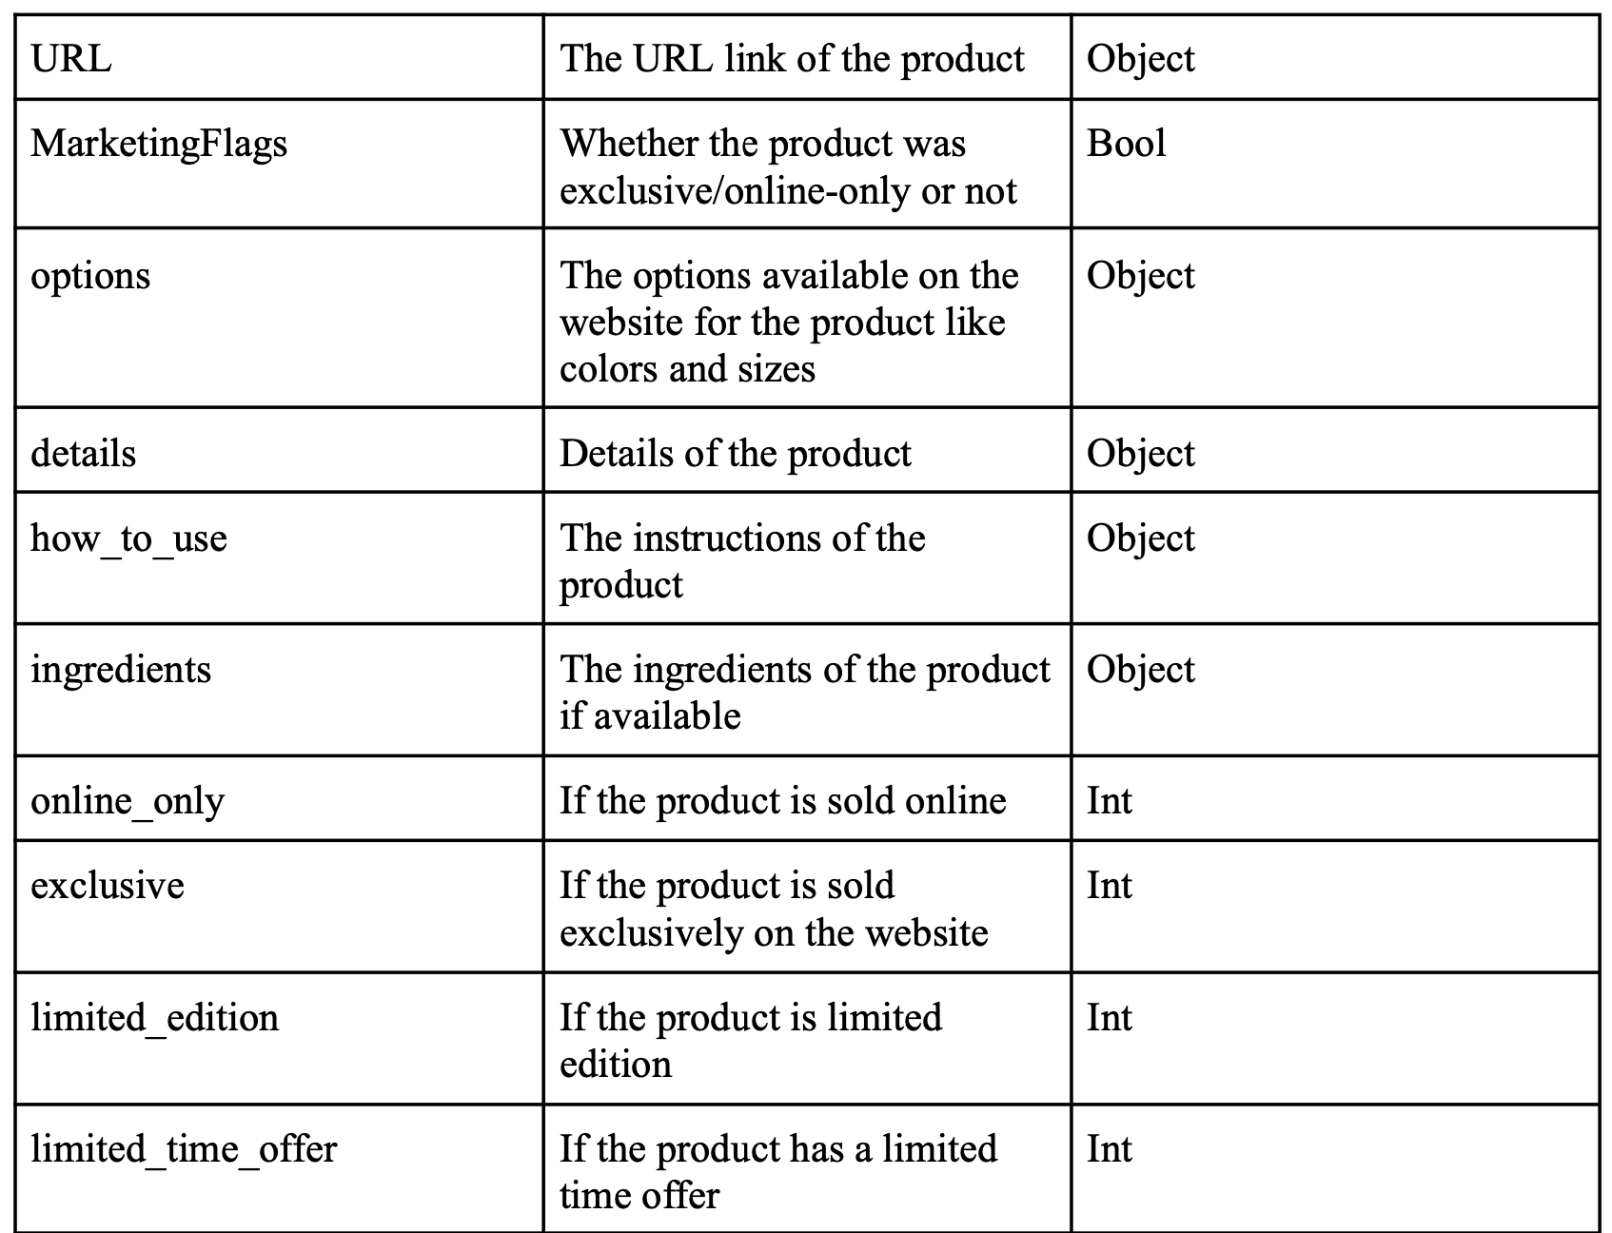
Data & Preprocessing
The dataset used in this project is from Kaggle, called Sephora Website. It has data that was scraped from Sephora’s website and includes over 9,000+ beauty products. To preprocess the data, all columns were analyzed to find their description, data type, and to see if they had any missing values. Irrelevant columns, like URL, were deleted, duplicates were also deleted, and new columns were added using other columns.

Slide 4
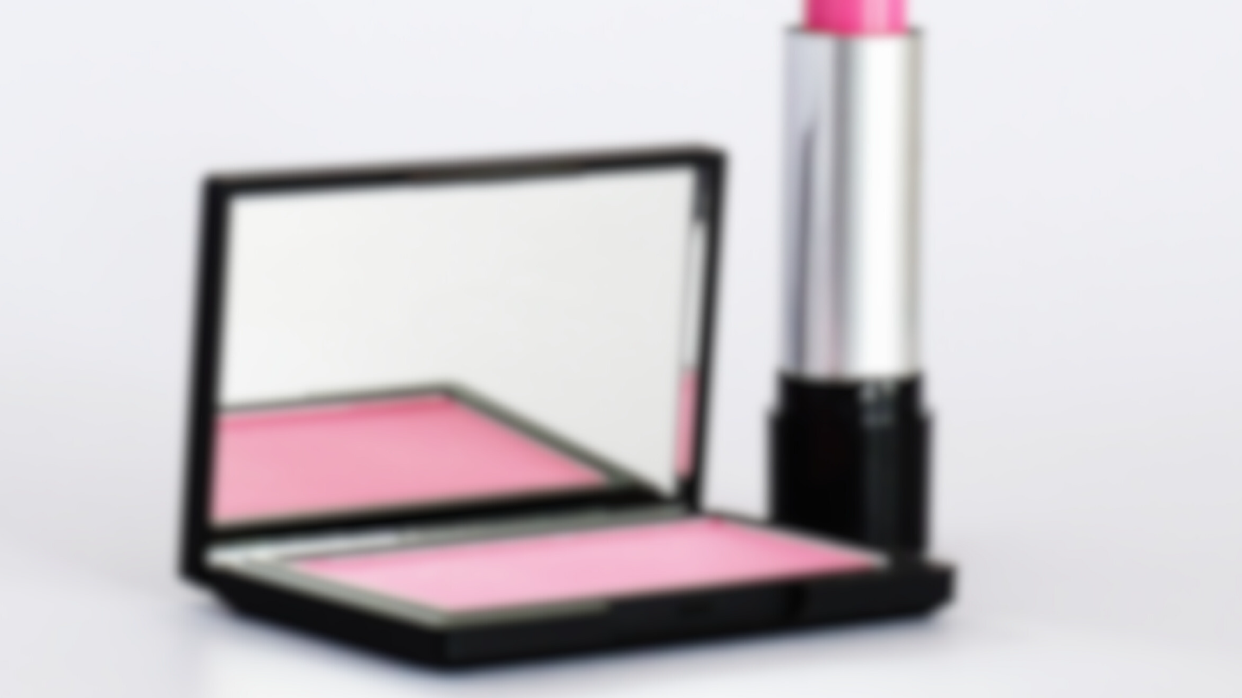
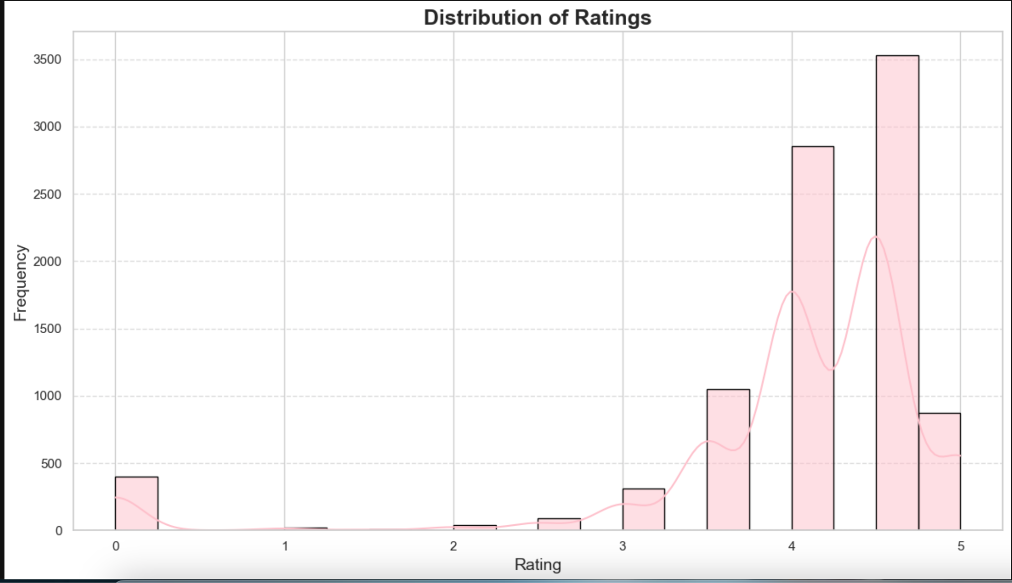
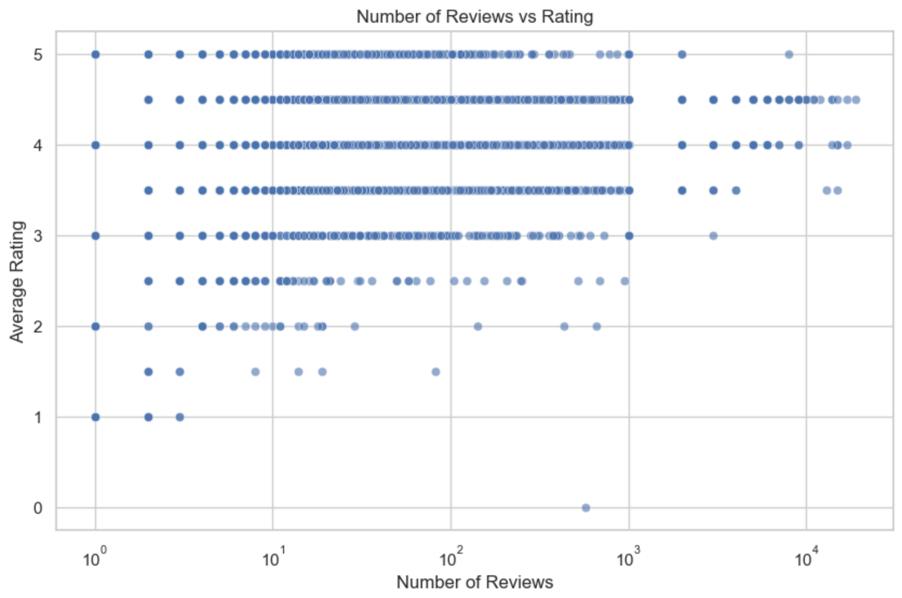
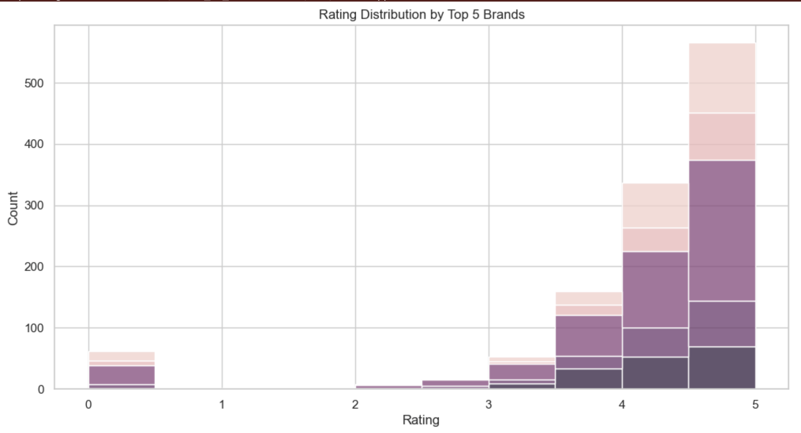
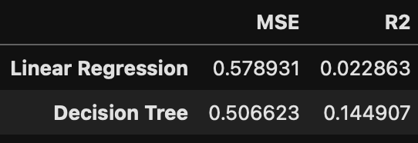
Key Insights

Slide 5
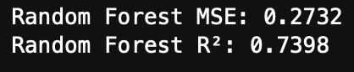
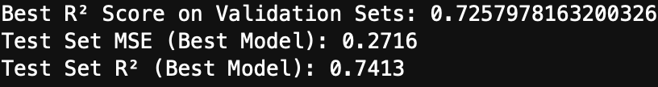
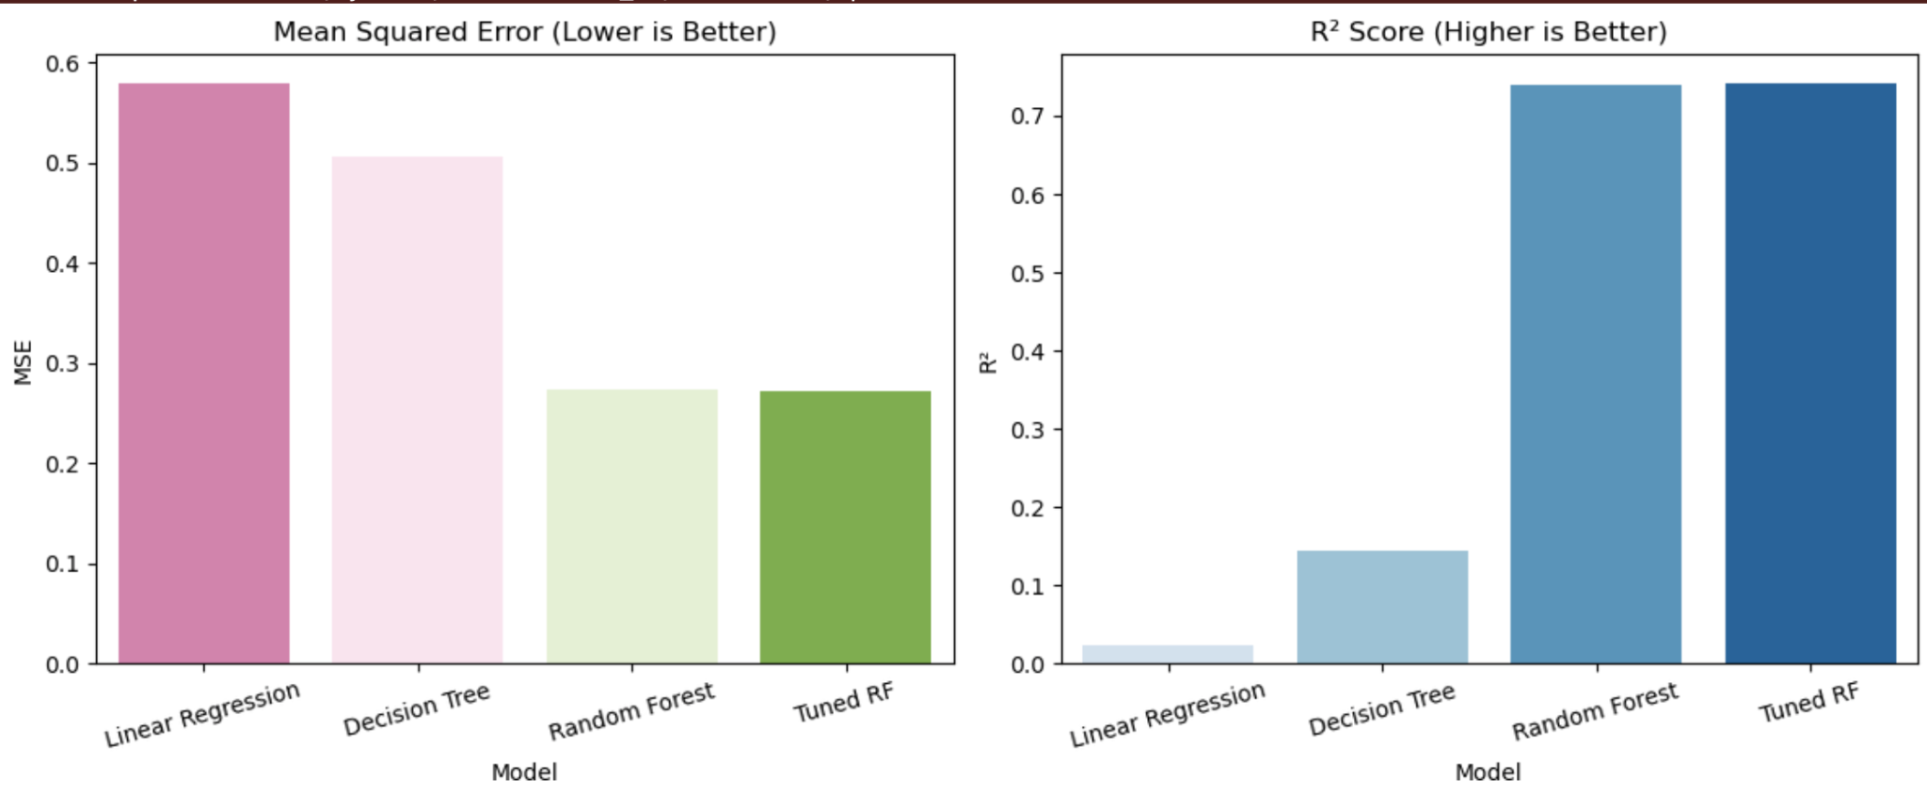
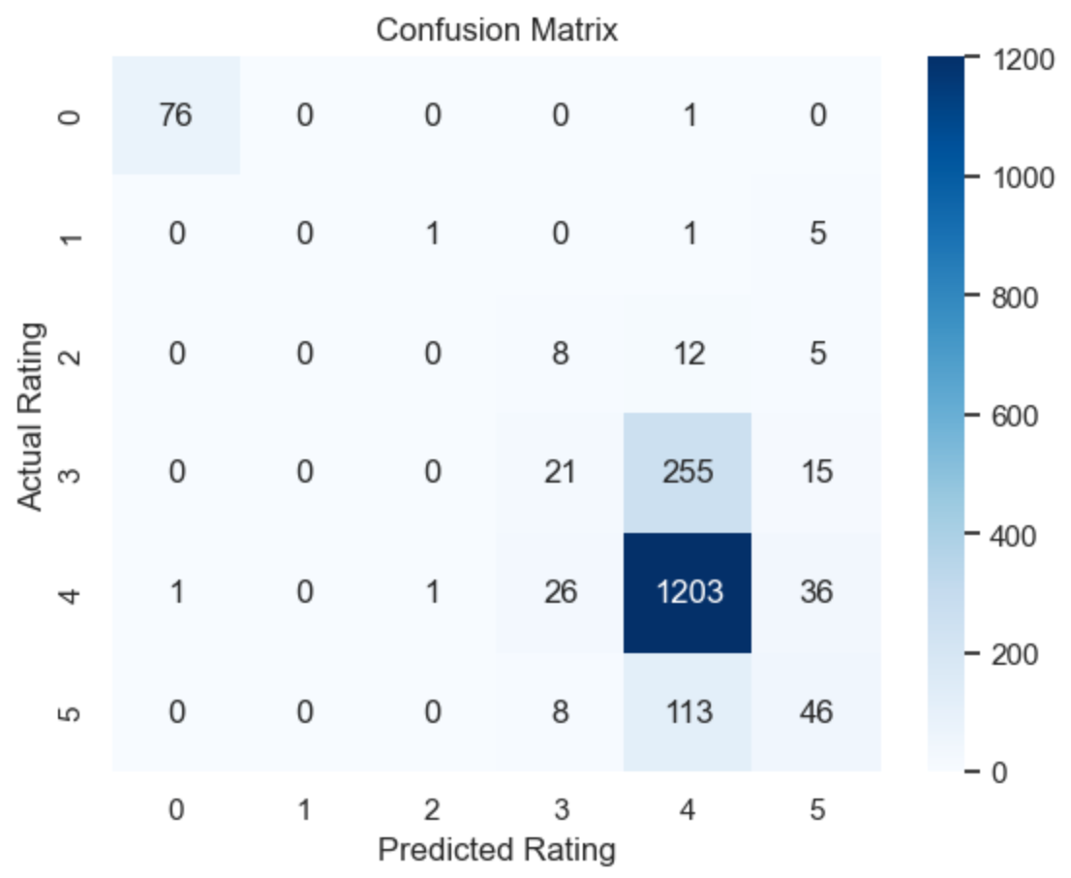
Random Forest Results:
Model Results and Interpretations:
Chosen Model: Random Forest Regression with hyperparameter tuning.
It has the best overall key performance indicators compared to the other models show.
Random Forest (Tuned):
Model Comparisons:
Random Forest Classification:

Slide 6
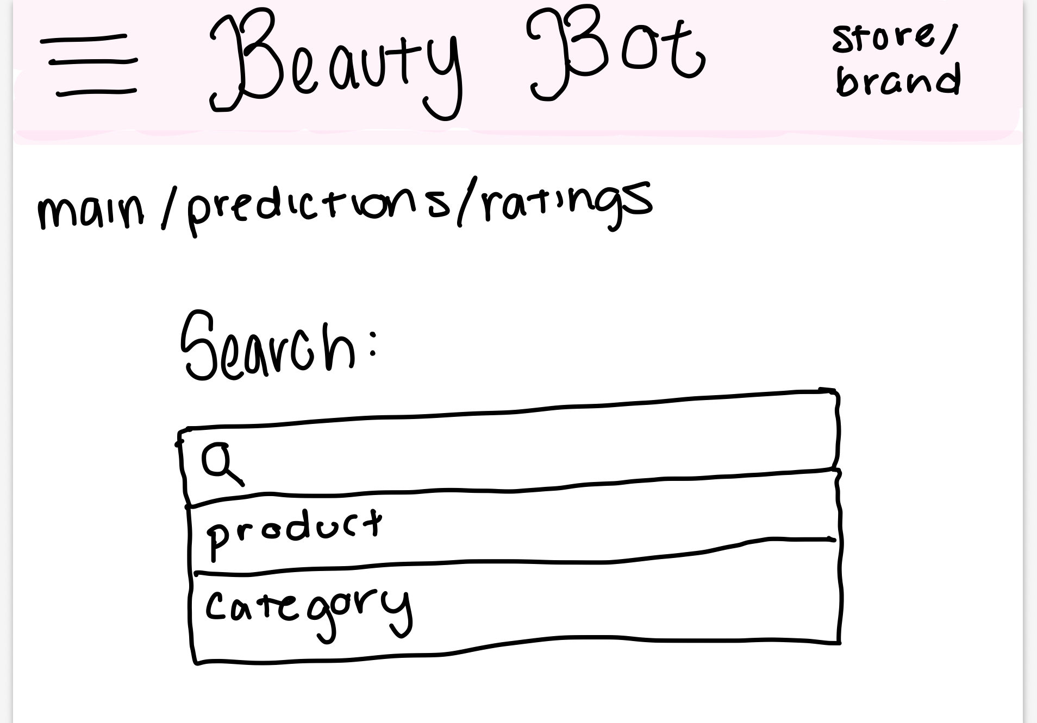
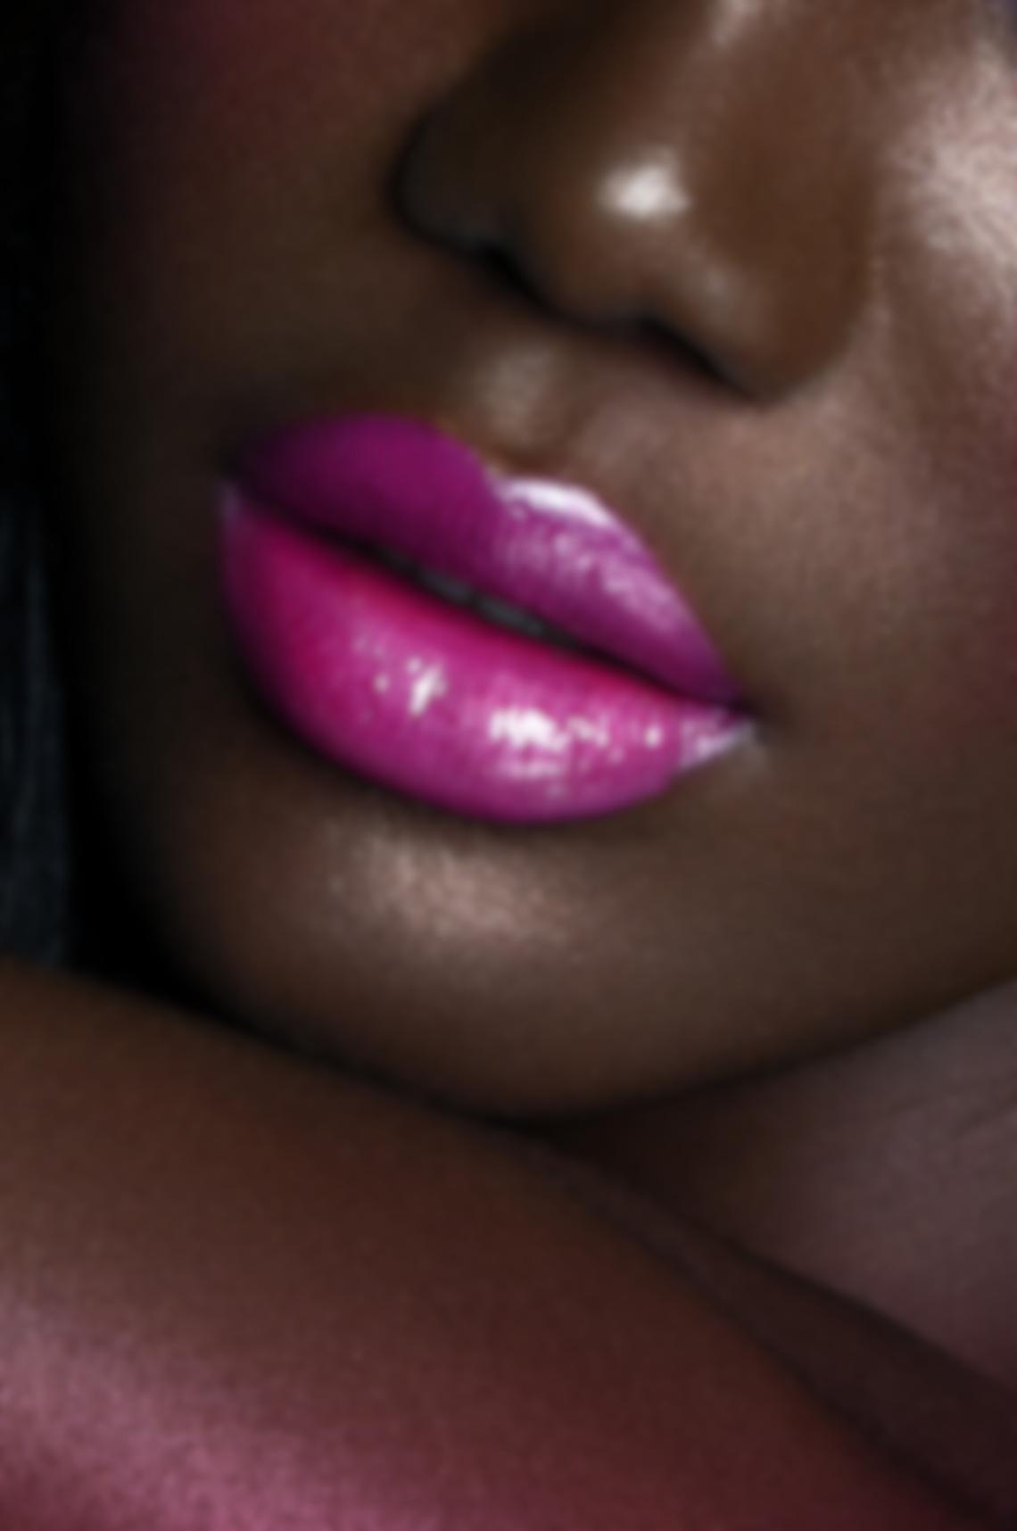
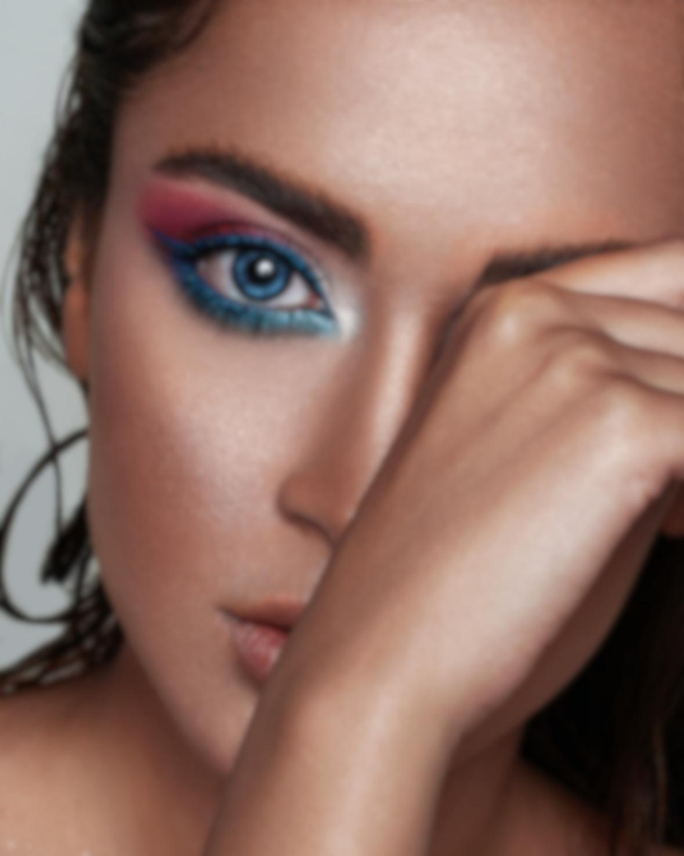
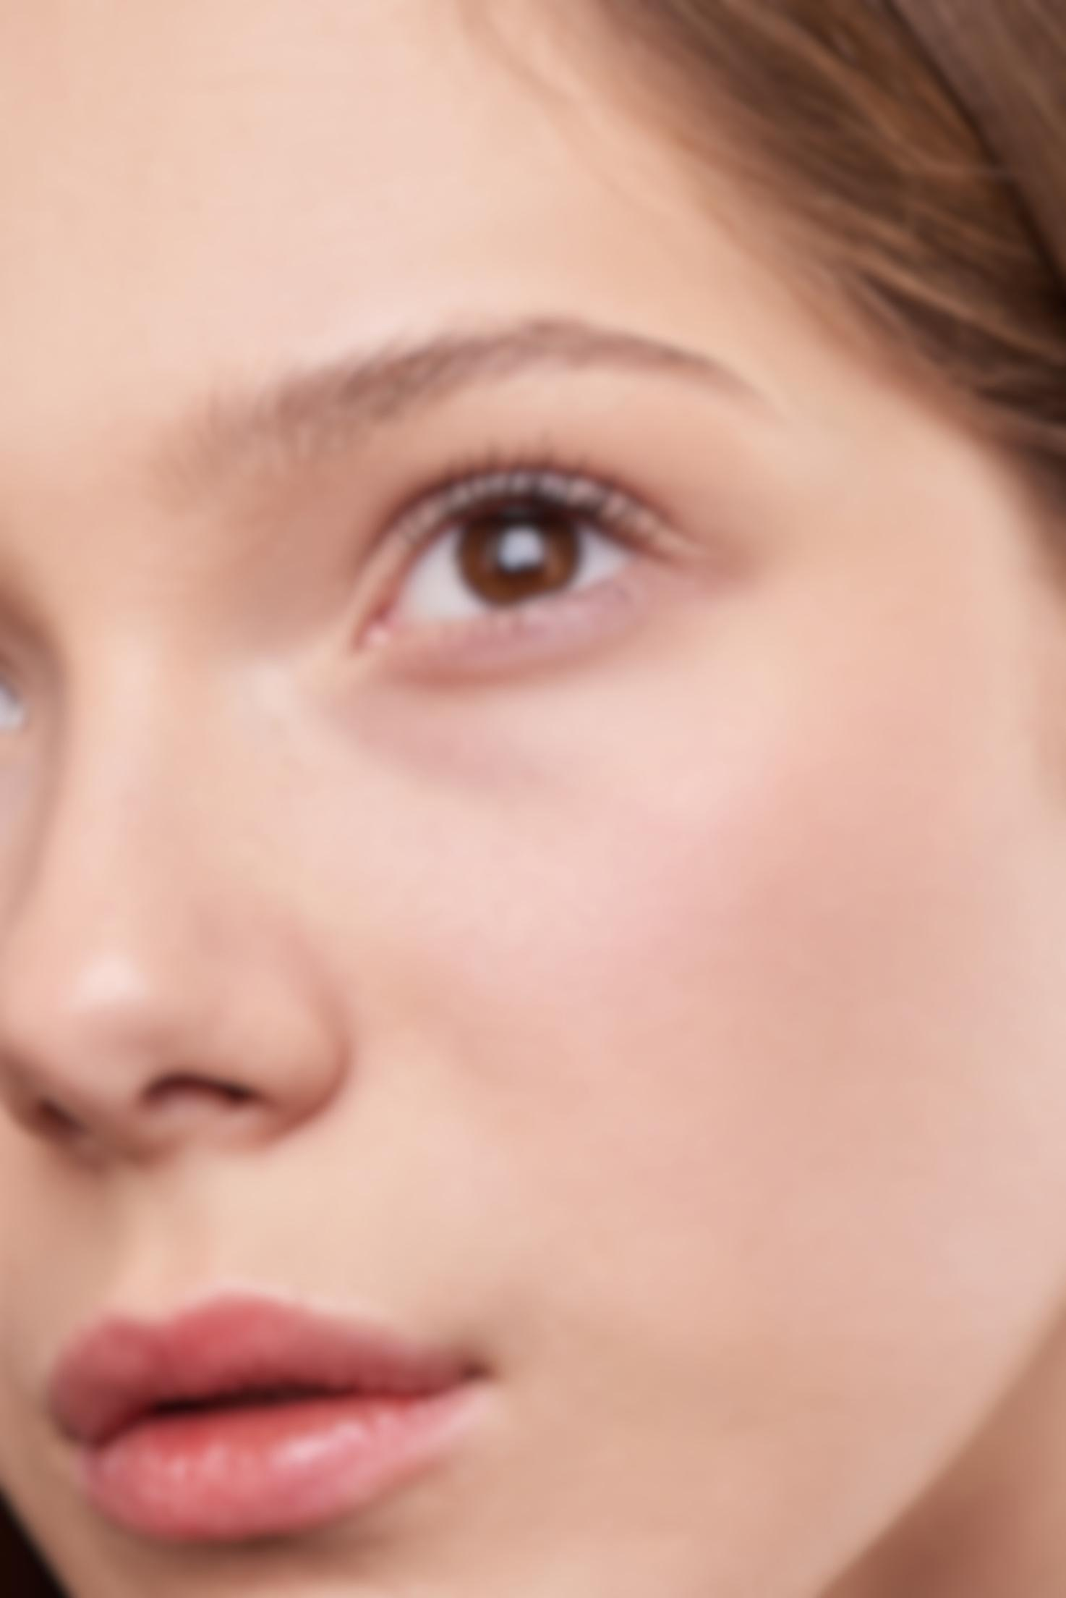
Next Steps
Extension and Expansion: BeautyBot will become a data-driven software tool for brands and beauty retailers that predicts product ratings, trends, and customer behavior. It also generates detailed customer personas based on reviews and purchase history, helping businesses make smarter marketing and inventory decisions at the tip of their fingers. Predictions will become stronger with using models such as XGBoost, yielding higher accuracy and lower bias.

Slide 7
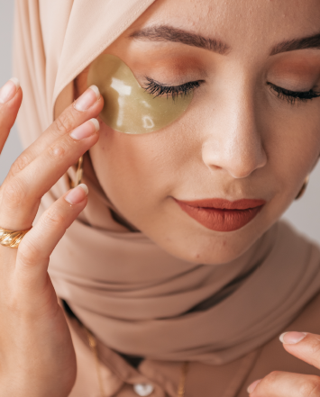
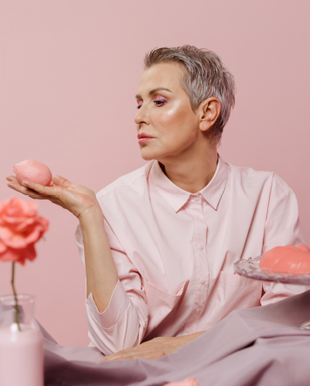
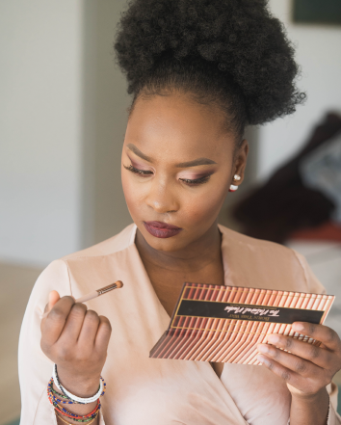
thank you
Where beauty meets brains — BeautyBot makes smarter strategies look effortless.

